Slide 1

Talent Acquisition and Resource Management using NLP
Pallavi Pandey (RA2011026010348)
Iram Kamdar (RA2011026010312)
Anunay Singh (RA2011026010313)

Slide 2
ABSTRACT
This project introduces a dual-module NLP-based framework designed to enhance both external candidate recruitment and internal candidate assignment within organizations. The first module leverages advanced NLP techniques to automate the screening of resumes, facilitating the identification and selection of external candidates whose skills and experience align closely with job descriptions. This model is meticulously engineered to ensure impartiality, eliminating biases related to culture, gender, or any non-relevant personal attributes, thereby promoting equity and diversity in the hiring process. The second module focuses on internal talent management, employing a sophisticated ranking system to match existing employees with projects that suit their skill sets and career aspirations.

Slide 3
INTRODUCTION
The first module aims to automate the resume screening process, enhancing efficiency, fairness, and diversity by eliminating biases related to gender, culture, and other non-relevant personal attributes. The second module focuses on optimizing internal resource allocation by matching employees with projects that align with their skill sets and career aspirations through a sophisticated ranking system. This comprehensive NLP-based approach not only addresses the inefficiencies and biases inherent in traditional HR practices but also underscores the potential of AI to streamline recruitment processes, foster workplace diversity, and improve organizational resource management. Through this initiative, the project seeks to contribute to the fields of human resource management and artificial intelligence by showcasing how advanced technologies can be leveraged to enhance talent acquisition strategies and internal talent development, paving the way for future research and practical applications in AI-enhanced HR practices.

Slide 4
MOTIVATION
The development of this System is driven by the need to resolve inefficiencies in traditional recruitment. A key goal is to cut down the time and effort in manual resume screening, thus speeding up the hiring process and improving organizational efficiency. The system also aims to promote fair hiring by using NLP to reduce unconscious bias, leading to a more diverse and inclusive workforce. Additionally, it focuses on improving the accuracy of job-candidate matching with advanced NLP techniques, ensuring candidates are selected based on their true fit for the role. This approach modernizes recruitment, making it more fair and efficient.

Slide 5
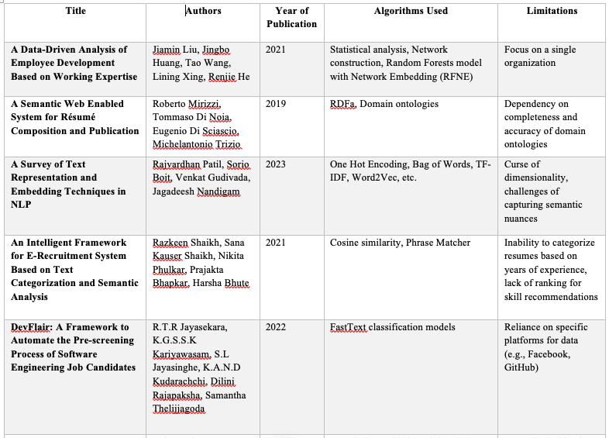
LITERATURE REVIEW

Slide 6
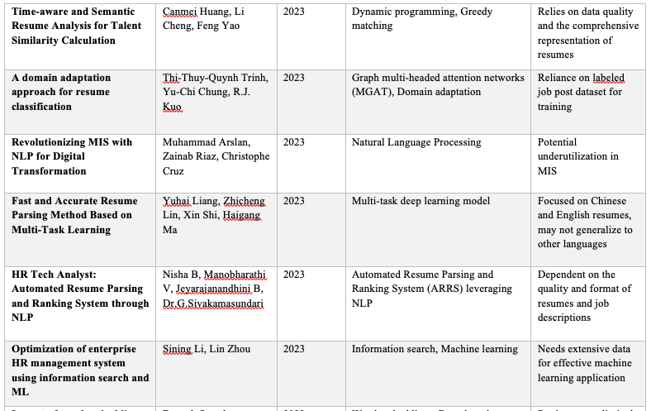

Slide 7
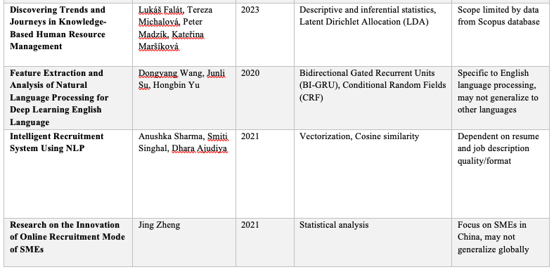
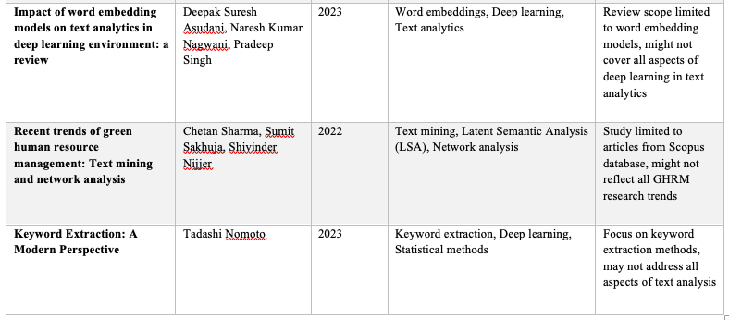

Slide 8
Challenges and Limitations in Existing System
Bias and Discrimination
Time-Consuming Processes
Inaccuracy in Candidate Selection
Limited Scalability.
Lack of Personalization

Slide 9
OBJECTIVES
1. Automate the Recruitment Process
2. Enhance Fairness and Reduce Bias
3. Improve Candidate Selection Accuracy
4. Scale with Organizational Growth
5. Personalize Talent Management

Slide 10
Innovation idea of the project
Multi-Dimensional Candidate Profiling
Sentiment and Topic Analysis for Cultural Fit
Dynamic Feedback and Ranking System

Slide 11
Scope and Application of the project
Wide Industry Applicability
Global Hiring Support
Scalable for Different Organization Sizes
Integration with Existing HR Systems
Enhancing Remote Hiring Processes
Adaptability to Various Recruitment Stages
Data-Driven Recruitment Decision Making

Slide 12
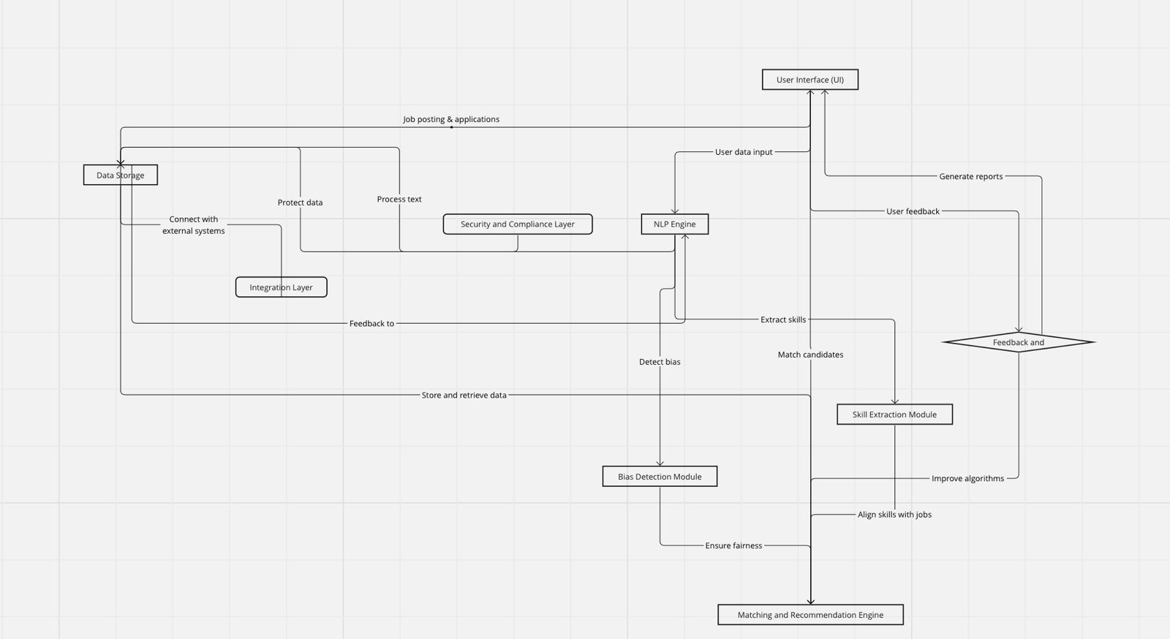
ARCHITECTURE

Slide 13
Proposed Modules and their Algorithms
1. Job Description Processing Module
Purpose: To analyze job descriptions for various tasks such as bias detection, skill extraction, and keyword optimization.
Algorithms and Techniques:
Bias Detection: Use pattern matching and sentiment analysis to identify biased language or phrases that could potentially discriminate against certain groups of applicants.
Skill Extraction: Employ Named Entity Recognition (NER) and custom pattern matching to extract required skills and qualifications from job descriptions.
Keyword Extraction: Utilize unsupervised keyword extraction algorithms like YAKE or TF-IDF (Term Frequency-Inverse Document Frequency) to identify important keywords for SEO.

Slide 14
2. Resume Analysis Module
Purpose: To parse and analyze resumes, extracting relevant information such as skills, experiences, and educational background.
Algorithms and Techniques:
Information Extraction: Use NER to identify personal details, skills, experiences, and education from unstructured resume texts.
Skill Matching: Implement cosine similarity or other similarity measures to match candidate skills with job description requirements.
Resume Ranking: Apply machine learning algorithms (e.g., Random Forest, SVM) to score and rank candidates based on the relevance of their profiles to the job description.

Slide 15
3. Cultural Fit Assessment
Purpose: To identify and mitigate biases in both job descriptions and the resume screening process to ensure fair and inclusive recruitment practices.
Algorithms and Techniques:
Fairness Metrics: Implement fairness metrics and algorithms to assess and ensure unbiased processing, such as demographic parity or equality of opportunity.
Bias Correction: Use techniques like adversarial debiasing or re-weighting to adjust models or outcomes for fairness.

Slide 16
4. Candidate-Job Matching Module
Purpose: To automatically match candidates with job openings based on their skills, experience, and the requirements of the job.
Algorithms and Techniques:
Matching Algorithms: Implement algorithms like Stable Marriage or Gale-Shapley for matching candidates to jobs in a way that optimizes preferences of both parties.
Recommendation Systems: Use collaborative filtering or content-based filtering to recommend jobs to candidates or candidates to recruiters.

Slide 17
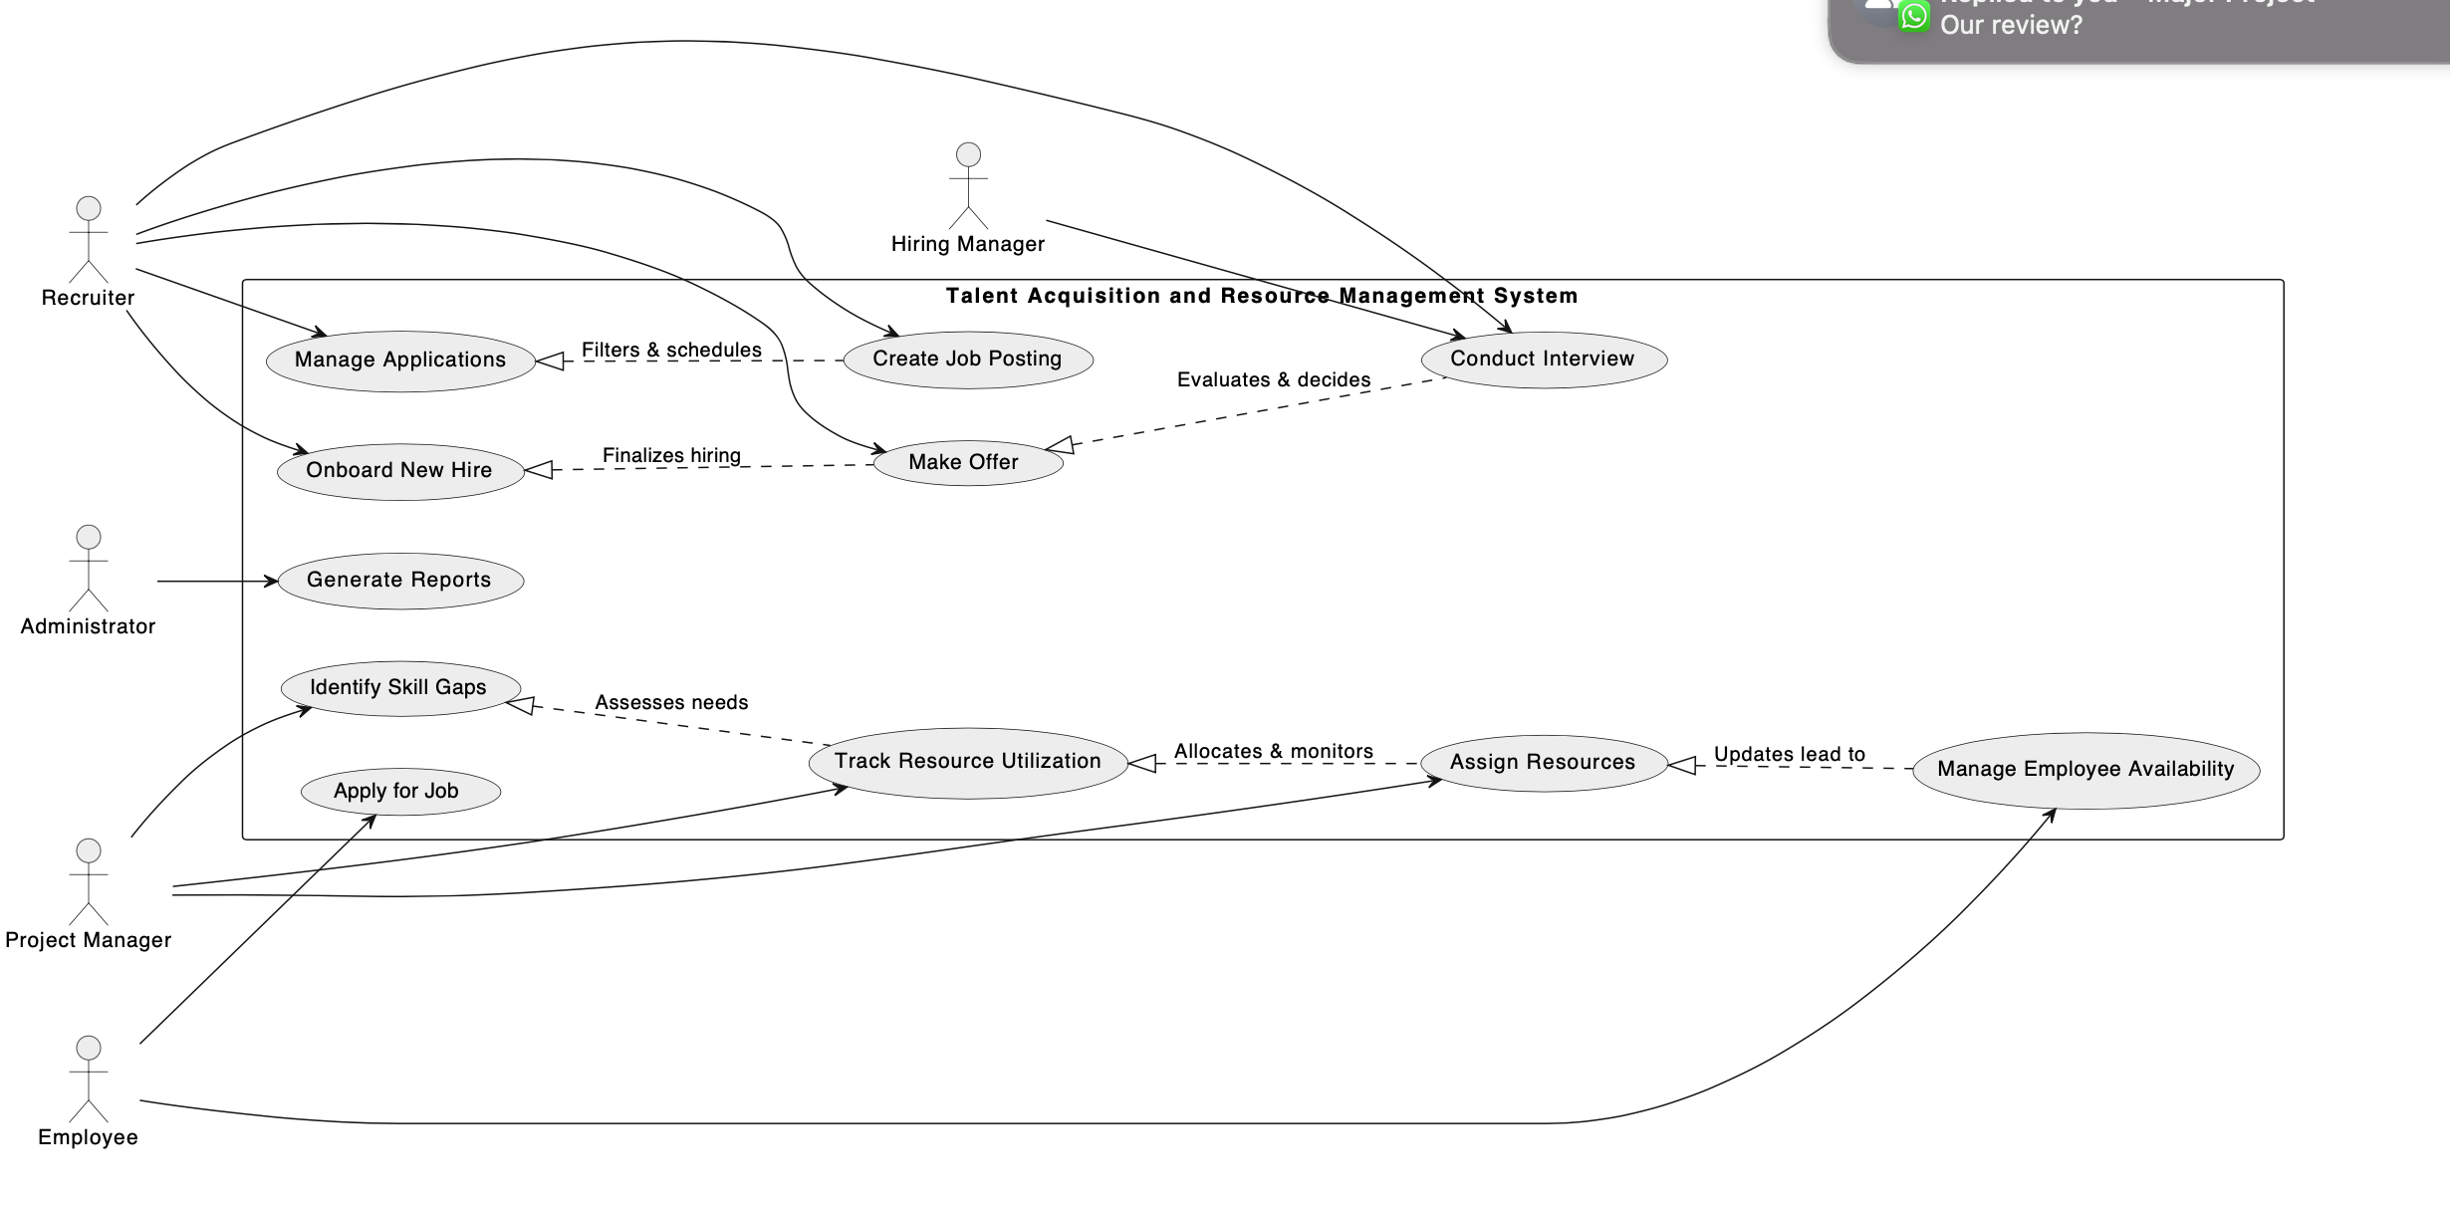
USE CASE DIAGRAM

Slide 18
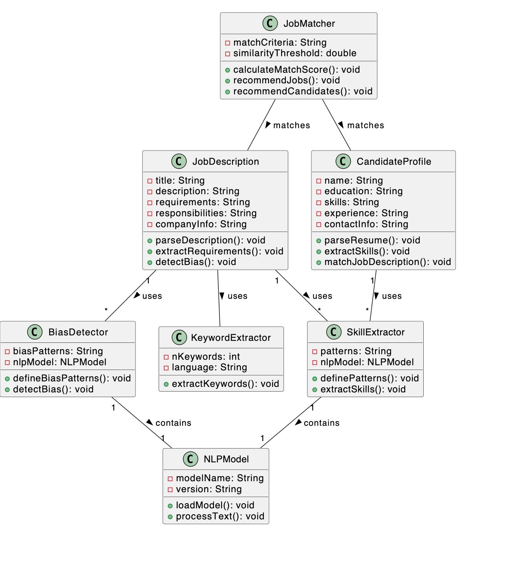
CLASS DIAGRAM

Slide 19
CONCLUSION
The NLP-powered Recruitment System is a big step forward in hiring. It uses advanced technology to make recruiting faster, fairer, and more accurate. Instead of the slow and sometimes biased way of reviewing resumes by hand, this system does it quickly and without bias. This makes it easier to find the right person for the job. The system is helpful for many types of businesses and shows how technology like AI and NLP can make hiring better.

